Slide 1
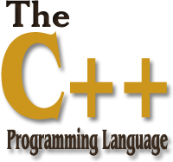
01
02
Lecture 5
04

Slide 2

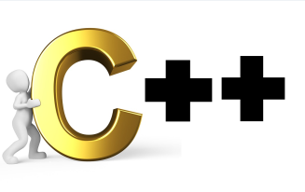
Today’s Agenda
01
Three Pillars Of OOP
02
Encapsulation
03
Polymorphism
04
Inheritance
05
Creating Parameterized Member Function
06

Slide 3

Three Pillars Of OOP
such OOP is collection of many principles but amongst them are three most
important principles called as ENCAPSULATION, POLYMORPHISM and
INHERITANCE.
Encapsulation:
The word Encapsulation is derived from a word called “Capsule”
Just like a capsule has a collection of multiple medicines wrapped in a single
block, similarly every program has only 2 important components which are
data & function.
Thus according to OOP these data & function must always be kept together.
So in terms of OOP, we can say that the word Encapsulation is defined as
“Bundling/Wrapping up of data and functions action on those data within
one single unit.”

Slide 4
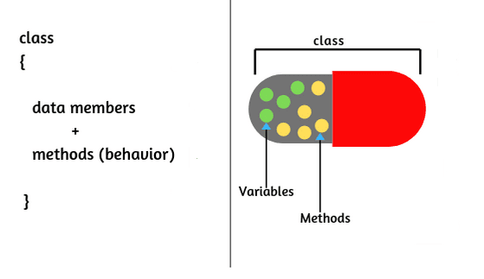
Encapsulation
Now since a class allows us to declare both data & function in it’s body , we can
say that it is an example of or implementation of the principle of Encapsulation.
The most important benefit offered by Encapsulation is Data Security
i.e. data members of a class are kept as private and thus they can not be
accessed directly from non member functions. This keeps the data safe and
secure from any kind of illegal and unauthorized access as well as makes it
Secure.
and define e

Slide 5
Polymorphism
Polymorphism
Poly
Morph
Multiple
Forms
or
Many
or
Implementation

Slide 6
Polymorphism
The word Polymorphism is derived from a combination of 2 words which are called
Poly and Morph. The word Poly means multiple and the word Morph means forms.
Thus the word Polymorphism means having multiple forms.
In other words we say that if a single entity can behave differently in different situation,
then it is behaving Polymorphically.
For ex:- In C++, if a programmer wants then he can redefine the built in operator + in
such a way that this operator can be used to concatenate 2 strings, just like it is used to
add 2 nos.
So, 10+20 will become 30 and “Good”+”Morning” will become “GoodMorning”.

Slide 7
Polymorphism
In C++ Polymorphism is divided in 2 parts:
a. Compile Time Polymorphism: Polymorphism that is resolved during compiler time
is known as Compile Time polymorphism. Ex. Function Overloading,
Operator Overloading.
b. Run Time Polymorphism: Run Time polymorphism is a process in which a call to
an overridden method is resolved at runtime, thats why it is called runtime
polymorphism . Ex:- Virtual Function, Pure Virtual Function and Abstract Classes.
The most important advantage offered by Polymorphism is Simplicity. This is
it is much more easy to use a Polymorphic code or function as compared to its
Non Polymorphic alternate.

Slide 8
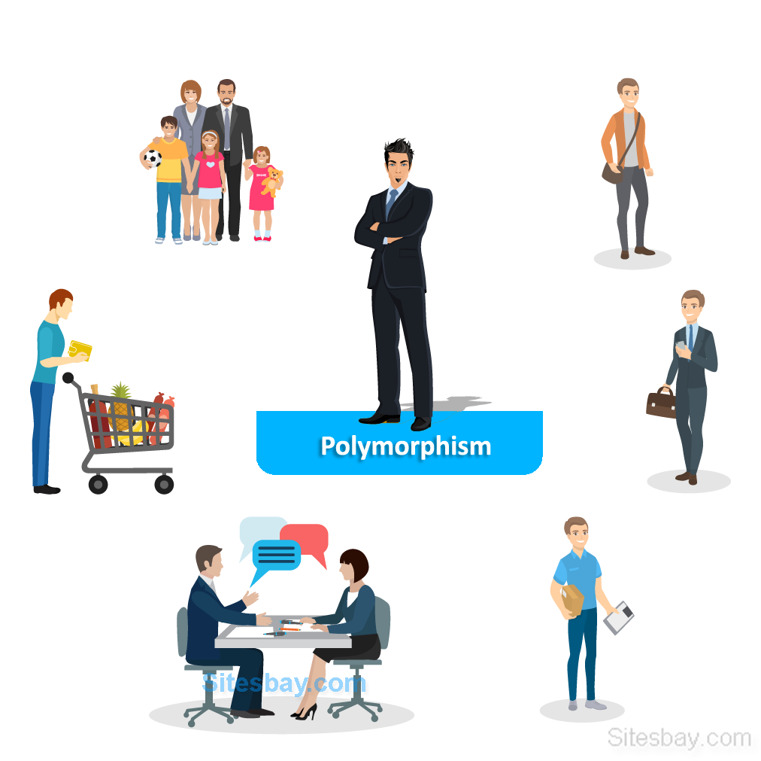
Polymorphism
.

Slide 9
Inheritance
To inherit means to acquire features of an existing entity in a newly
created entity.
Just like a child inherits the features of his or her parents, similarly in OOP
we can inherit the features (data & member functions) of an existing class in
a newly created class.
When we do this we say that we have implemented inheritance.
The class which gets inherited is called as parent class (OOP term) or base class
(C++ terms) or super class(Python or Java term)
.

Slide 10
Inheritance
The class which inherits is called as child class (OOP terms) or derived
class(C++ term) or sub class(Python or Java term).
Thus via inheritance the programmer of derived class gets the advantage of
accessing members of the base class also using the object of derived class.
The most important benefit offered by inheritance is code reusability.
This means that the derived class programmer is not required to rewrite those
functions again which have already been coded by the base class programmer.
This lot of time and effort on the part of derived class programmer.
.

Slide 11
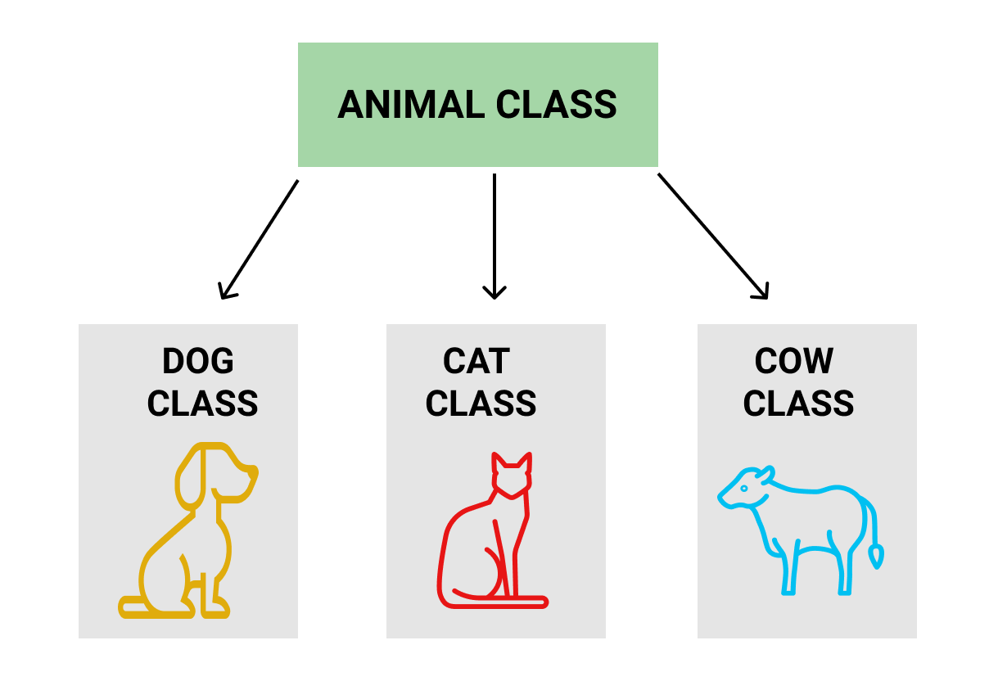
Inheritance
.
Example:-

Slide 12
End of Lecture 5
For any queries mail us @: scalive4u@gmail.com
Call us @ : 0755-4271659, 7879165533
Thank you

